Slide 1
Introduction to R language

Slide 2
Why R?
Most popular environment in statistics and machine learning communities.
Open source, fast growing ecosystem.
Packages for almost everything:
Data processing and cleaning
Data visualization
Interactive web-apps
Accomplishes the things you might be used to do doing in Stata (data processing, fitting standard models) and those you might be used to doing in MATLAB (numerical programming).

Slide 3
Alternative to R
Stata (proprietary): Most popular statistical software in economics, easy to use for standard methods, not a good programming language.
MATLAB (proprietary): Numerical programming environment, matrix based. Programming in (base) R is quite similar to MATLAB.
Python (open): General purpose programming language, standard in industry, not targeted toward data analysis and statistics, but lots of development for machine learning. More overhead to write relative to R.
Julia (open): New language for numerical programming, fast, increasingly popular in macro / for solving complicated structural models, not geared toward data analysis.

Slide 4

Installing R & RStudio
Install R:
https://cran.rstudio.com/
Install RStudio:
https://www.rstudio.com/products/rstudio/download/
R Studio requires an installation of R 3.0. 1 or higher. You can download the most recent version of R for your environment from CRAN.
Notes:
The RStudio IDE is a set of integrated tools designed to help you be more productive with R and Python. It includes a console, syntax-highlighting editor that supports direct code execution, and a variety of robust tools for plotting, viewing history, debugging and managing your workspace.

Slide 5
R Overview
You can enter commands one at a time at the command prompt (>) or run a set of commands from a source file.
There is a wide variety of data types, including vectors (numerical, character, logical), matrices, data frames, and lists.
To quit R, use
>q()
Most functionality is provided through built-in and user-created functions and all data objects are kept in memory during an interactive session.
Basic functions are available by default. Other functions are contained in packages that can be attached to a current session as needed

Slide 6
R Overview
Results of calculations can be stored in objects using the assignment operators:
An arrow (<-) formed by a smaller than character and a hyphen without a space.
The equal character (=).
e.g > a=5
> b<-a #copy value of a into b
These objects can then be used in other calculations. To print the object just enter the name of the object. There are some restrictions when giving an object a name:
Object names cannot contain `strange' symbols like !, +, -, #.
A dot (.) and an underscore (_) are allowed, also a name starting with a dot.
Object names can contain a number but cannot start with a number.
R is case sensitive, X and x are two different objects, as well as temp and temP.

Slide 7
Example 1:
> # An example # represent comments
> x <- c(1:10)
> x[(x>8) | (x<5)]
> # yields 1 2 3 4 9 10
> # How it works
> x <- c(1:10)
> x
>1 2 3 4 5 6 7 8 9 10
> x > 8
> F F F F F F F F T T
> x < 5
> T T T T F F F F F F
> x > 8 | x < 5
> T T T T F F F F T T
> x[c(T,T,T,T,F,F,F,F,T,T)]
> 1 2 3 4 9 10

Slide 8
Default Functions: ls() & rm()
#EXAMPLE CODE #Creating a vector vec <- c(1, 2, 3) # Creating a matrix mat <- matrix(c(1:4), 2) # Calling ls() Function ls() #Calling ls(pattern=“v”) ls(pattern=“v”) #Calling remove function rm(vec) ls()
ls() function in R Language is used to list the names of all the objects that are present in the working directory.
rm():
If you assign a value to an object that already exists then the contents of the object will be overwritten with the new value (without a warning!). Use the function rm to remove one or more objects from your session.> rm(x, x2)
Output:
[1] “vec" "mat“
[1] “vec”
[1] “mat”

Slide 9
Default Functions: getwd(), setwd() & help
getwd() # print the current working directory
ls() # list the objects in the current workspace
setwd(mydirectory) # change to mydirectory
setwd("c:/docs/mydir")
help.start() # general help
help(foo) # help about function foo
?foo # same thing

Slide 10

R Datasets:
R comes with a number of sample datasets that you can experiment with. Type
data( ) or >library(help=“datasets”)
to see the available datasets. The results will depend on which packages you have loaded. Type
help(datasetname)
for details on a sample dataset.

Slide 11
R Packages
The system allows you to write new functions and package those functions in a so-called R package' (or `R library’).
When you download R, already a number (around 30) of packages are downloaded as well. To use a function in an R package, that package has to be attached to the system.
To attach another package to the system you can use the menu or the library function. Use following commands:
> install.packages(“pacman”) #install pacman libray
>library(“pacman”) or require(“pacman”) #load pacman library
The function library can also be used to list all the available libraries on your system with a short description. Run the function without any arguments
> library()

Slide 12

Reusing Results
One of the most useful design features of R is that the output of analyses can easily be saved and used as input to additional analyses.
# Example 1 lm(mpg~wt, data=mtcars)
This will run a simple linear regression of miles per gallon on car weight using the dataframe mtcars. Results are sent to the screen. Nothing is saved.
# Example 2 fit <- lm(mpg~wt, data=mtcars)
This time, the same regression is performed but the results are saved under the name fit. No output is sent to the screen. However, you now can manipulate the results.
str(fit) # view the contents/structure of "fit“
The assignment has actually created a list called "fit" that contains a wide range of information (including the predicted values, residuals, coefficients, and more.

Slide 13
Reusing Results
# plot residuals by fitted values plot(fit$residuals, fit$fitted.values)
To see what a function returns, look at the value section of the online help for that function. Here we would look at help(lm).
The results can also be used by a wide range of other functions.
# produce diagnostic plots plot(fit)

Slide 14

Data Types

Slide 15
Data Types
R has a wide variety of data types including scalars, vectors (numerical, character, logical), matrices, dataframes, and lists.
VECTORS:
a <- c(1,2,5.3,6,-2,4) # numeric vector
b <- c("one","two","three") # character vector
c <- c(TRUE,TRUE,TRUE,FALSE,TRUE,FALSE)
#logical vector
Refer to elements of a vector using subscripts.
a[c(2,4)] # 2nd and 4th elements of vector

Slide 16
Data Types
MATRICES
All columns in a matrix must have the same mode(numeric, character, etc.) and the same length.
The general format is:
mymatrix <- matrix(vector, nrow=r, ncol=c, byrow=FALSE, dimnames=list(char_vector_rownames, char_vector_colnames))
byrow=TRUE indicates that the matrix should be filled by rows. byrow=FALSE indicates that the matrix should be filled by columns (the default). dimnames provides optional labels for the columns and rows.

Slide 17
Data Types
MATRICES EXAMPLE
Y<-matrix(1:20)
# generates 5 x 4 numeric matrix y<-matrix(1:20, nrow=5,ncol=4)
# another example cells <- c(1,26,24,68) rnames <- c("R1", "R2") cnames <- c("C1", "C2") mymatrix <- matrix(cells, nrow=2, ncol=2, byrow=TRUE, dimnames=list(rnames, cnames))
#Identify rows, columns or elements using subscripts.
y[,4] # 4th column of matrix
y[3,] # 3rd row of matrix
y[2:4,1:3] # rows 2,3,4 of columns 1,2,3

Slide 18
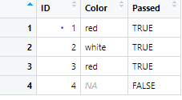
Data Types
ARRAYS:
Arrays are similar to matrices but can have more than two dimensions. See help(array) for details.
DATA FRAME:
A data frame is more general than a matrix, in that different columns can have different modes (numeric, character, factor, etc.).
d <- c(1,2,3,4)
e <- c("red", "white", "red", NA)
f <- c(TRUE,TRUE,TRUE,FALSE)
mydata <- data.frame(d,e,f)
names(mydata) <- c("ID","Color","Passed")
#variable names
There are a variety of ways to identify the elements of a dataframe .
myframe[3:5] # columns 3,4,5 of dataframe
myframe[c("ID","Age")] # columns ID and Age from dataframe
myframe$X1 # variable x1 in the dataframe

Slide 19
Data Types
LISTS:
An ordered collection of objects (components). A list allows you to gather a variety of (possibly unrelated) objects under one name.
# example of a list with 4 components - # a string, a numeric vector, a matrix, and a scaler
w <- list(name="Fred", mynumbers=a, mymatrix=y, age=5.3)
# example of a list containing two lists
list1<-list(name="Fred", mynumbers=a, mymatrix=y, age=5.3)
list2<-list(name="Fred", mynumbers=a, mymatrix=y, age=5.3)
v <- c(list1,list2)
#Identify elements of a list using the [[]] convention.
v[[2]] # 2nd component of the list

Slide 20
FACTORS
Factors in R Programming Language are data structures that are implemented to categorize the data or represent categorical data and store it on multiple levels.
Attributes of Factors in R Language
x: It is the vector that needs to be converted into a factor.
Levels: It is a set of distinct values which are given to the input vector x.
Labels: It is a character vector corresponding to the number of labels.
Exclude: This will mention all the values you want to exclude.
Ordered: This logical attribute decides whether the levels are ordered.
nmax: It will decide the upper limit for the maximum number of levels.

Slide 21
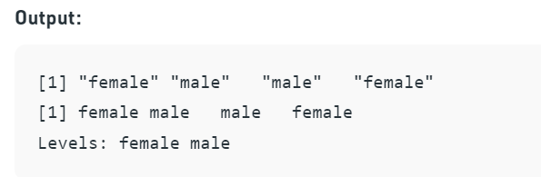

FACTORS Example
# Creating a vector
x < -c("female", "male", "male", "female")
print(x)
# Converting the vector x into a factor
# named gender
gender < -factor(x)
print(gender)
# Creating a factor with levels defined by programmer
gender <- factor(c("female", "male", "male", "female"),
levels = c("female", "transgender", "male"));
Gender
age <- c(40, 49, 48, 40, 67, 52, 53)
salary <- c(103200, 106200, 150200,
10606, 10390, 14070, 10220)
gender <- c("male", "male", "transgender",
"female", "male", "female", "transgender")
employee<- data.frame(age, salary, gender)
print(employee)
X<-factor(employee$gender)
X
*Practice: https://www.geeksforgeeks.org/r-factors/#:~:text=Factors%20in%20R%20Programming%20Language,label%20to%20every%20unique%20integer.

Slide 22
Factors
food <- factor(c("low", "high", "medium", "high", "low", "medium", "high"))
food <- factor(food, levels = c("low", "medium", "high"))
levels(food)
[1] "low" "medium" "high"
min(food) # doesn't work
Error in Summary.factor(structure(c(1L, 3L, 2L, 3L, 1L, 2L, 3L), .Label = c("low", : 'min' not meaningful for factors
food <- factor(food, levels = c("low", "medium", "high"), ordered = TRUE) levels(food)
[1] "low" "medium" "high"
min(food) # works!
[1] low Levels: low < medium < high
Notes:
https://swcarpentry.github.io/r-novice-inflammation/12-supp-factors/index.html

Slide 23
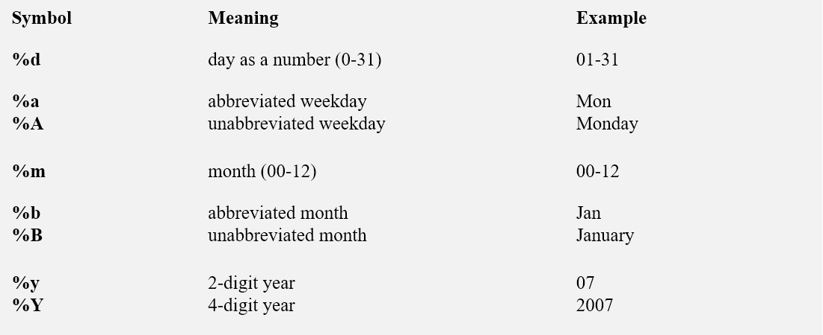
Date Values
Dates are represented as the number of days
since 1970-01-01, with negative values for earlier dates.
# use as.Date( ) to convert strings to dates
mydates <- as.Date(c("2007-06-22", "2004-02-13"))
# number of days between 6/22/07 and 2/13/04 days <- mydates[1] - mydates[2]
Sys.Date( ) returns today's date.
Date() returns the current date and time.
# print today's date
today <- Sys.Date()
format(today, format="%B %d %Y") "June 20 2007"

Slide 24

Importing Data in R language

Slide 25
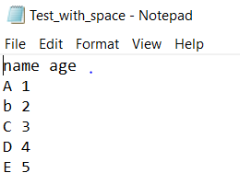
Reading From Text File
Basic syntax
read.table(file, # TXT data file indicated as string or full path to the file
header = FALSE, # Whether to display the header (TRUE) or not (FALSE)
sep = "", # Separator of the columns of the file
dec = ".") # Character used to separate decimals of the numbers in the file
getwd() #get working directory
setwd("D:/Downloads")
mydata1 <- read.table(file="Test_with_space.txt", header=TRUE)

Slide 26
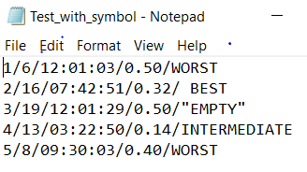
Reading From Text File
Example 2: # when file data is separated by \
getwd() #get working directory
setwd("D:/Downloads")
File<read.table("D:/Downloads/
Test_with_symbol.txt” , header = FALSE,
sep="/",
strip.white = TRUE,
na.strings = "EMPTY")
*https://r-coder.com/read-txt-r/

Slide 27
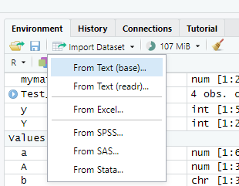
Importing Text file
Click Import Dataset
Select-> FromText(base) -> Select the directory from where you want to import

Slide 28
Importing Excel file
getwd()
setwd("D:/Downloads")
Excel<-read.csv("Data.csv", header=TRUE)
head(Excel)
summary(Excel)
*For practice: https://www.tutorialspoint.com/r/r_csv_files.htm

Slide 29
Exporting Data
In Excel:
# Create a data frame.
data <- read.csv("input.csv")
retval <- subset(data, as.Date(start_date) > as.Date("2014-01-01"))
# Write filtered data into a new file.
write.csv(retval,"output.csv")
newdata <- read.csv("output.csv")
print(newdata)
write.table(x, file, append = FALSE, sep = " ", dec = ".", row.names = TRUE, col.names = TRUE)
Write data from R to a txt file:
write.table(my_data, file = “my_data.txt”, sep = “”)
Write data from R to a csv file:
write.csv(my_data, file = “my_data.csv”)

Slide 30
Viewing Data
There are a number of functions for listing the contents of an object or dataset.
# list objects in the working environment ls()
# list the variables in mydata names(mydata)
# list the structure of mydata str(mydata)
# list levels of factor v1 in mydata levels(mydata$v1)
# dimensions of an object dim(object)
#class of an object (numeric, matrix,
dataframe, etc) class(object)
# print mydata mydata
# print first 10 rows of mydata head(mydata, n=10)
# print last 5 rows of mydata tail(mydata, n=5)

Slide 31

PLOTTING

Slide 32
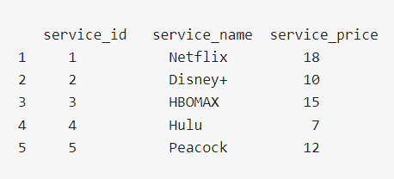
Dollar Sign in R language
To access a variable in the R dataset, use the dollar sign($). The $ operator can be used to select a variable/column, assign new values to a variable/column, or add a new variable/column in an R object.
streaming <- data.frame( service_id = c(1:5), service_name = c("Netflix", "Disney+", "HBOMAX", "Hulu", "Peacock"), service_price = c(18, 10, 15, 7, 12), stringsAsFactors = FALSE ) # Print the data frame.
print(streaming)

Slide 33
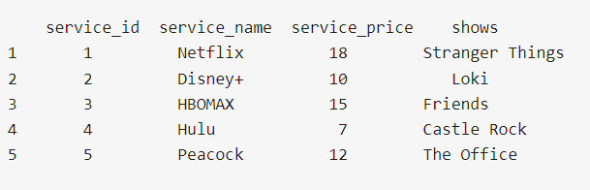

Dollar Sign in R language
Add new column
Print column
streaming$shows <- c("Stranger Things", "Loki", "Friends", "Castle Rock", "The Office") print(streaming)
print(streaming$service_name)

Slide 34
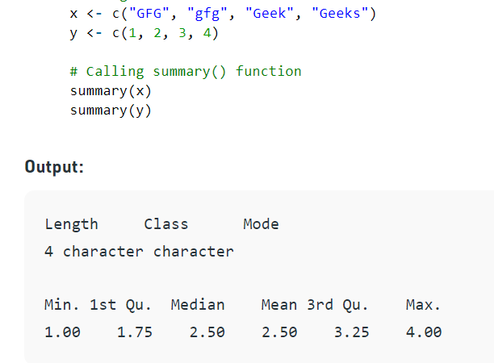
Summary Function
Syntax: summary(object, maxsum)

Slide 35
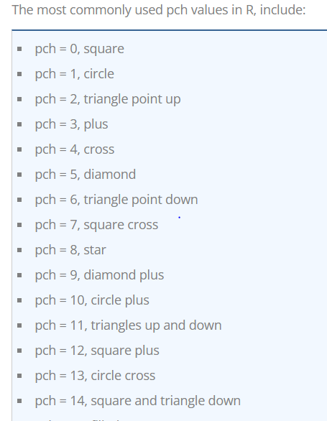
Plot() Function
Parameter | Description
x | The coordinates of points in the plot
y | The y coordinates of points in the plot
type | The type of plot to be drawn
main | An overall title for the plot
xlab | The label for the x axis
ylab | The label for the y axis
pch | The shape of points
col | The foreground color of symbols as well as lines
In R, the base graphics function to create a plot is the plot() function. It has many options and arguments to control many things, such as the plot type, labels, titles and colors.
Syntax
The syntax for the plot() function is:
plot(x,y,type,main,xlab,ylab,pch,col,las,bty,bg,cex,…)

Slide 36
Plot() Function
library(datasets) # Load/unload base packages manually
# LOAD DATA ################################################
head(iris)
# PLOT DATA WITH PLOT() ####################################
?plot # Help for plot()
plot(iris$Species) # Categorical variable
plot(iris$Petal.Length) # Quantitative variable
plot(iris$Species, iris$Petal.Width) # Cat x quant
plot(iris$Petal.Length, iris$Petal.Width) # Quant pair
plot(iris) # Entire data frame
# Plot with options
plot(iris$Petal.Length, iris$Petal.Width,
col = "#cc0000", # Hex code for datalab.cc red
pch = 19, # Use solid circles for points
main = "Iris: Petal Length vs. Petal Width",
xlab = "Petal Length",
ylab = "Petal Width")

Slide 37
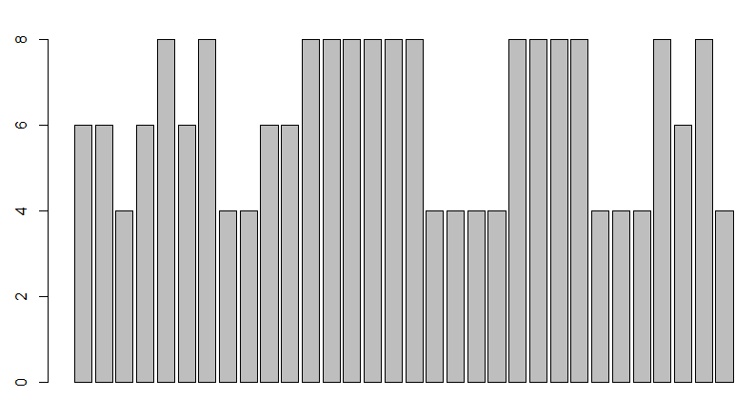
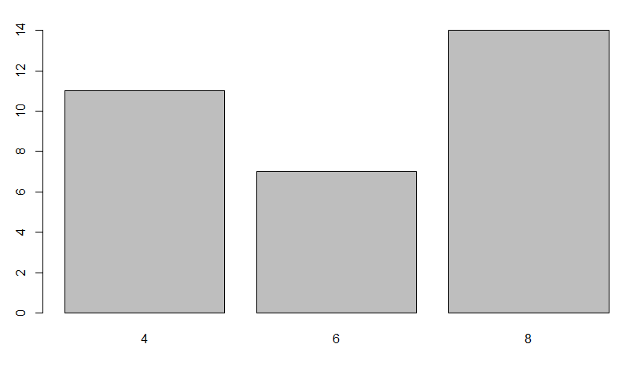
Bar Plot
library(datasets)
# LOAD DATA ################################################
?mtcars
head(mtcars)
# BAR CHARTS ###############################################
barplot(mtcars$cyl) # Doesn't work
# Need a table with frequencies for each category
cylinders <- table(mtcars$cyl) # Create table
barplot(cylinders) # Bar chart
plot(cylinders) # Default X-Y plot (lines)

Slide 38
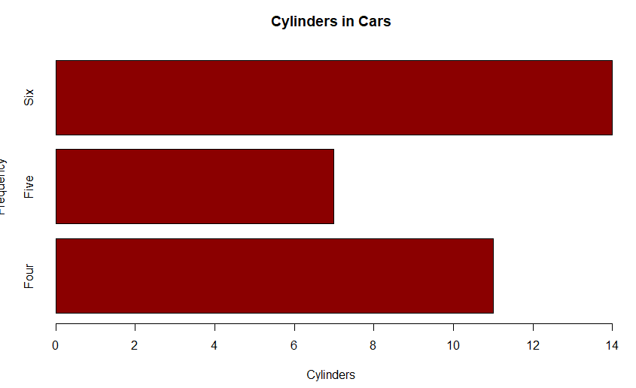
Bar Plot
barplot(cylinders,
main = "Cylinders in Cars",
xlab = "Cylinders",
ylab = "Frequency",
names.arg = c("Four", "Five", "Six"),
col = "darkred",
horiz = TRUE)

Slide 39
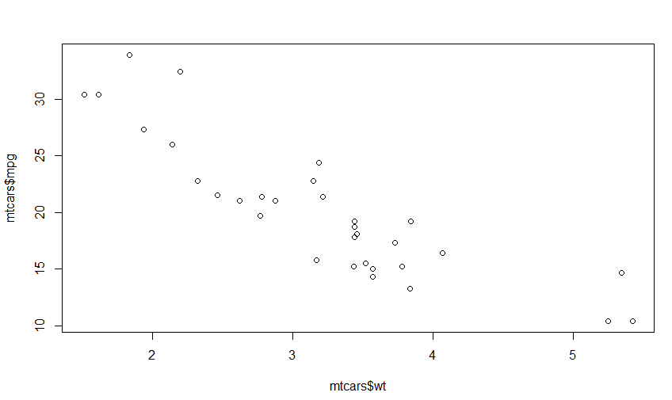
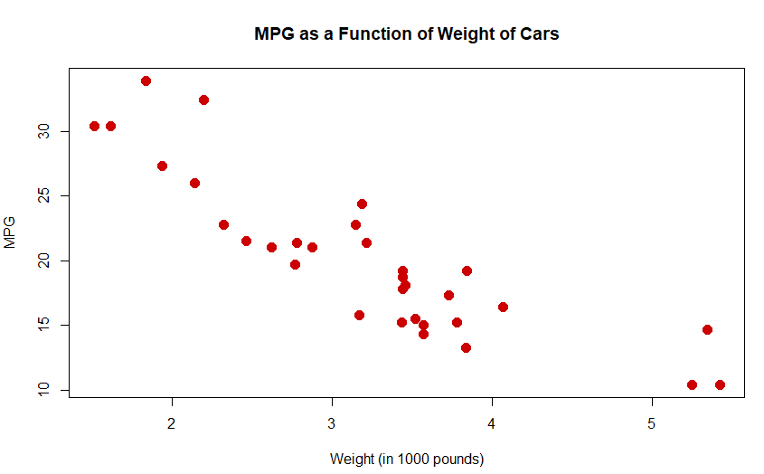
Scatter Plot
# Basic X-Y plot for two quantitative variables
plot(mtcars$wt, mtcars$mpg)
# Add some options
plot(mtcars$wt, mtcars$mpg,
pch = 19, # Solid circle
cex = 1.5, # Make 150% size
col = "#cc0000", # Red
main = "MPG as a Function of Weight of Cars",
xlab = "Weight (in 1000 pounds)",
ylab = "MPG")

Slide 40
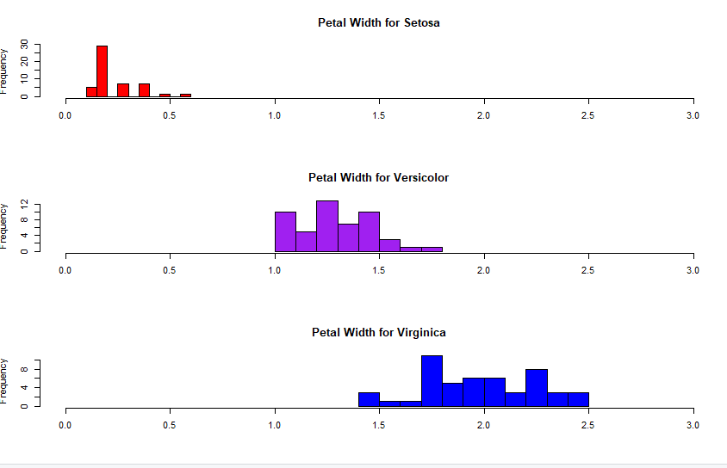
Histogram
Histograms for each species using options
hist(iris$Petal.Width [iris$Species == "setosa"],
xlim = c(0, 3),
breaks = 9, #no of bins
main = "Petal Width for Setosa",
xlab = "",
col = "red")
hist(iris$Petal.Width [iris$Species == "versicolor"],
xlim = c(0, 3),
breaks = 9,
main = "Petal Width for Versicolor",
xlab = "",
col = "purple")
hist(iris$Petal.Width [iris$Species == "virginica"],
xlim = c(0, 3),
breaks = 9,
main = "Petal Width for Virginica",
xlab = "",
col = "blue")
# Restore graphic parameter
par(mfrow=c(1, 1))
?iris
head(iris)
# BASIC HISTOGRAMS #########################################
hist(iris$Sepal.Length)
hist(iris$Sepal.Width)
hist(iris$Petal.Length)
hist(iris$Petal.Width)
# HISTOGRAM BY GROUP #######################################
# Put graphs in 3 rows and 1 column
par(mfrow = c(3, 1))
Notes:
The breaks argument controls the number of bars, cells or bins of the histogram

Slide 41
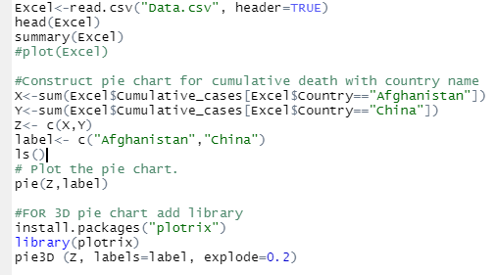
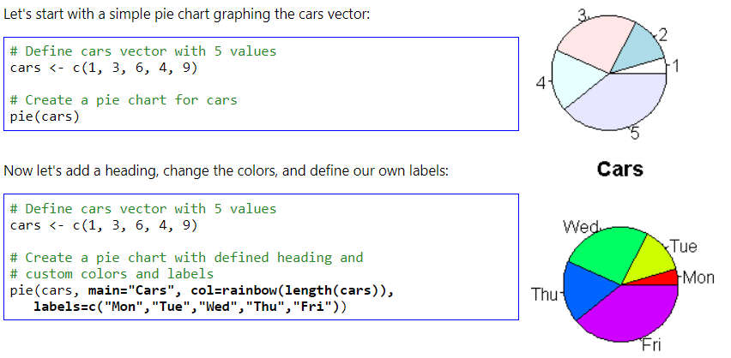
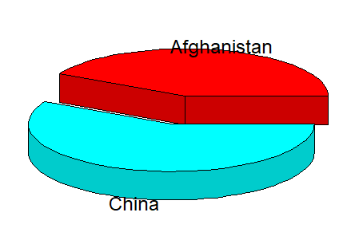
Pie Charts

Slide 42
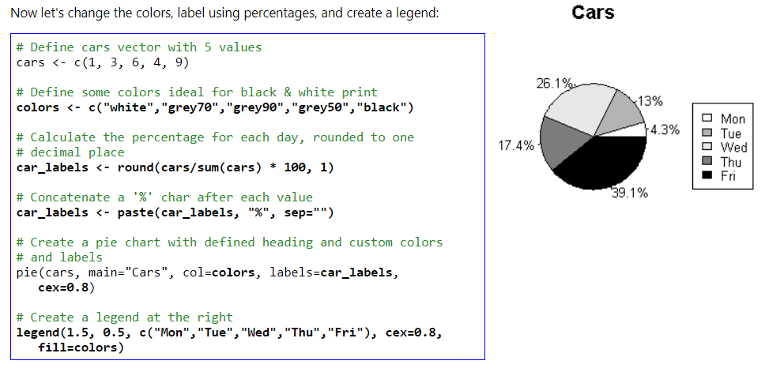
Pie Charts

